Slide 1
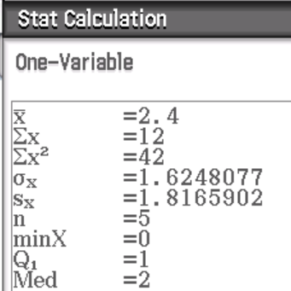
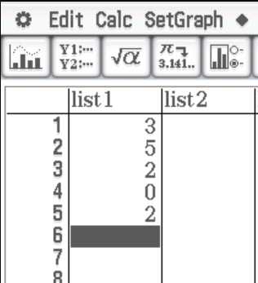
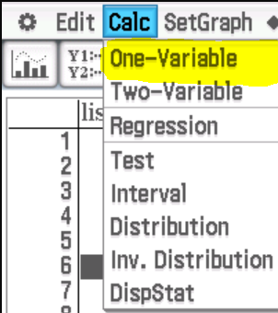
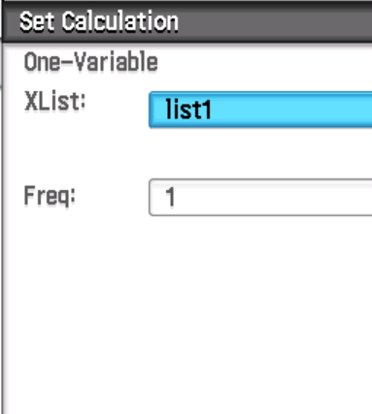
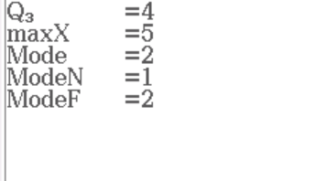
Calculating Standard Deviation on a Class Pad
Find the mean and standard deviation of 3, 5, 2, 0 and 2.
MEAN
SD

Slide 2


Calculating Standard Deviation on a Class Pad
Standard deviation is a measure of spread.
For most data sets, very few, if any scores would be more than 3 standard deviations away from the mean.
This means the vast majority of scores (probably all of them) lie between:
Frequently, approximately two-thirds of the scores would be within 1 standard deviation of the mean.

Slide 3
Calculating Standard Deviation on a Class Pad
1.62 is the standard deviation of the 5 scores.
The other value (sx = 1.82) is the standard deviation we use if our values are a sample of a larger data set and we want to use the standard deviation of the sample to estimate the standard deviation of the whole data set.
Only use sx if you are asked to.

Slide 4
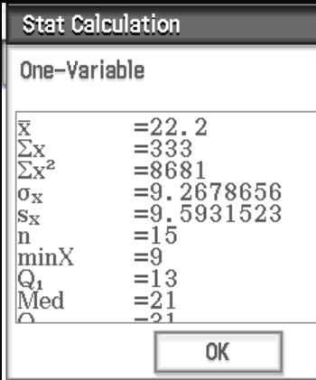

Calculating Standard Deviation on a Class Pad
Now do Exercise 3B
Find the mean and standard deviation for the set of scores.
9, 10, 11, 13, 19, 20, 21, 21, 22, 24, 25, 31, 31, 32, 44
How many of the scores lie between 1 standard deviation of the mean?
How many scores lie between 2 standard deviations of the mean?
Using Class Pad, we get a mean of 22.2 and a standard deviation of 9.27 (to 2dp).
$22.2−9.27=12.93$and $22.2+9.27=31.47$
10 of the 15 scores lie between 1 standard deviation of the mean.
$22.2−2(9.27)=3.66$and $22.2+2(9.27)=40.74$
14 of the 15 scores lie between 2 standard deviations of the mean.

